Slide 1
Climate Science
The (enhanced) greenhouse effect and observed climate change
General circulation models
Projected climate change

Slide 2
Lectures
Science
Scenarios & emission reduction options
Costs of emission reduction
Instruments for emission reduction
Impacts and adaptation
Economic impacts of climate change
Reading week
Climate and development
Optimal emission reduction
Discounting, uncertainty, equity
International environmental agreements

Slide 3
Climate Science
The (enhanced) greenhouse effect and observed climate change
General circulation models
Projected climate change

Slide 4
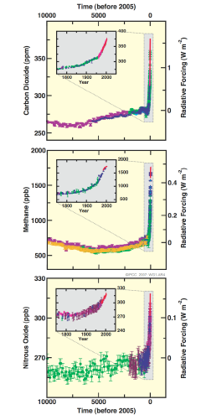

Slide 5
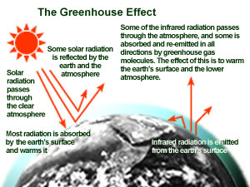

Slide 6
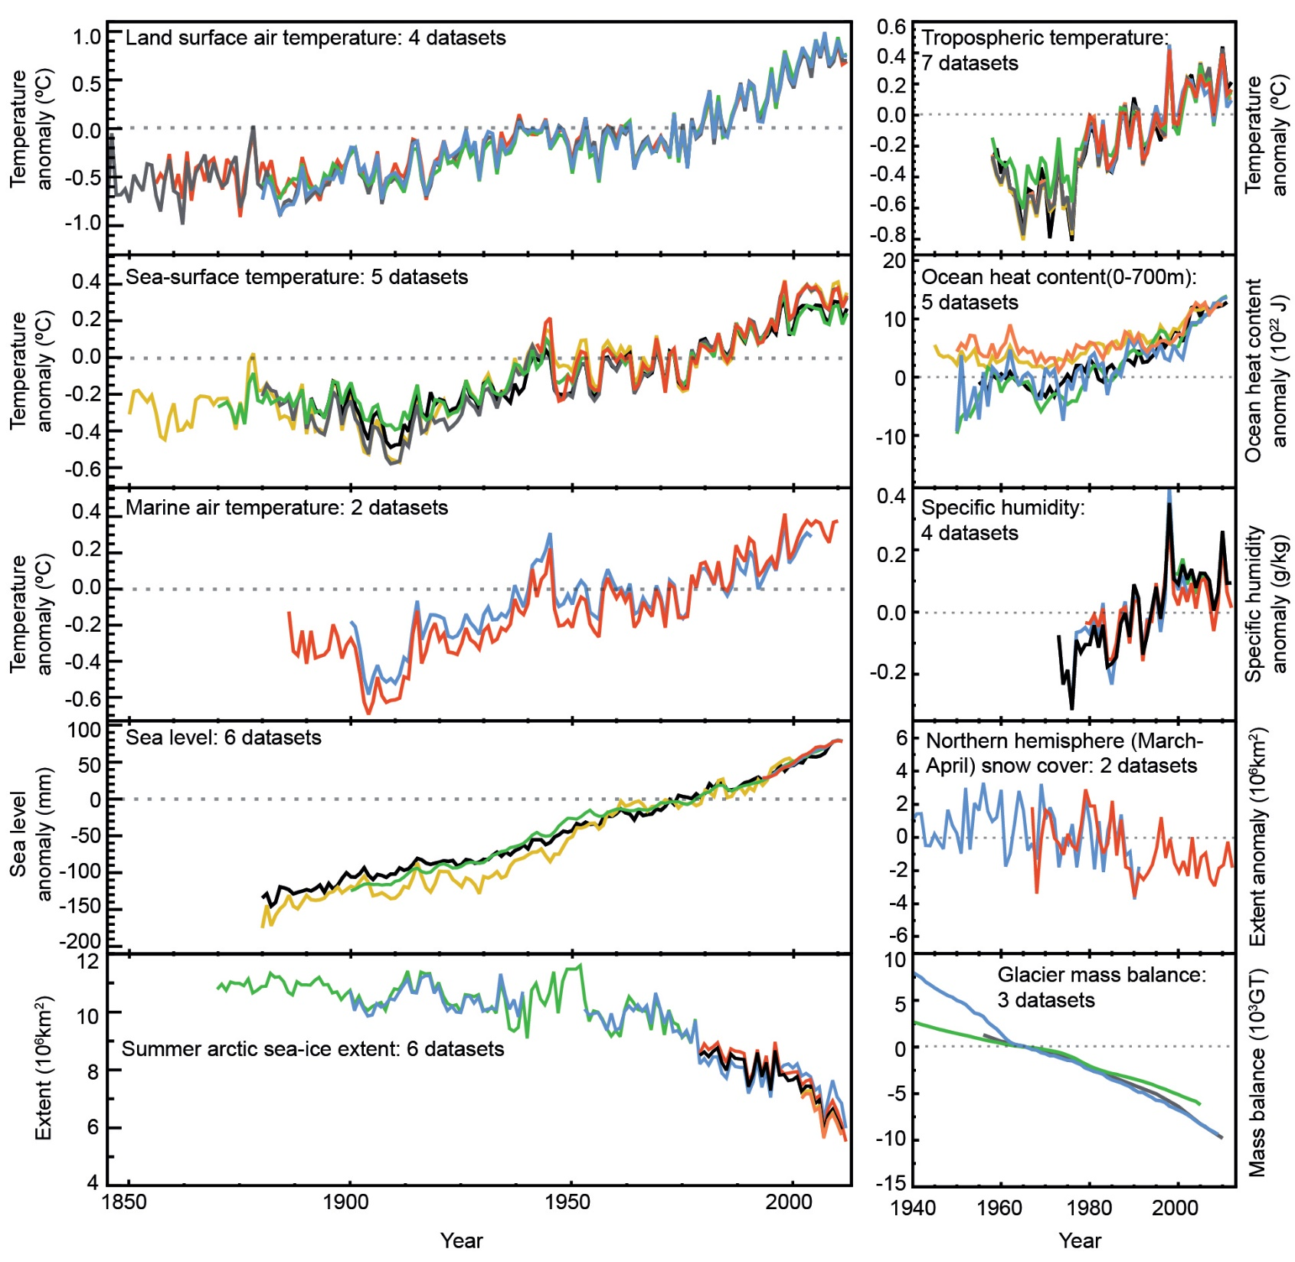

Slide 7
Climate Science
The (enhanced) greenhouse effect and observed climate change
General circulation models
Projected climate change

Slide 8
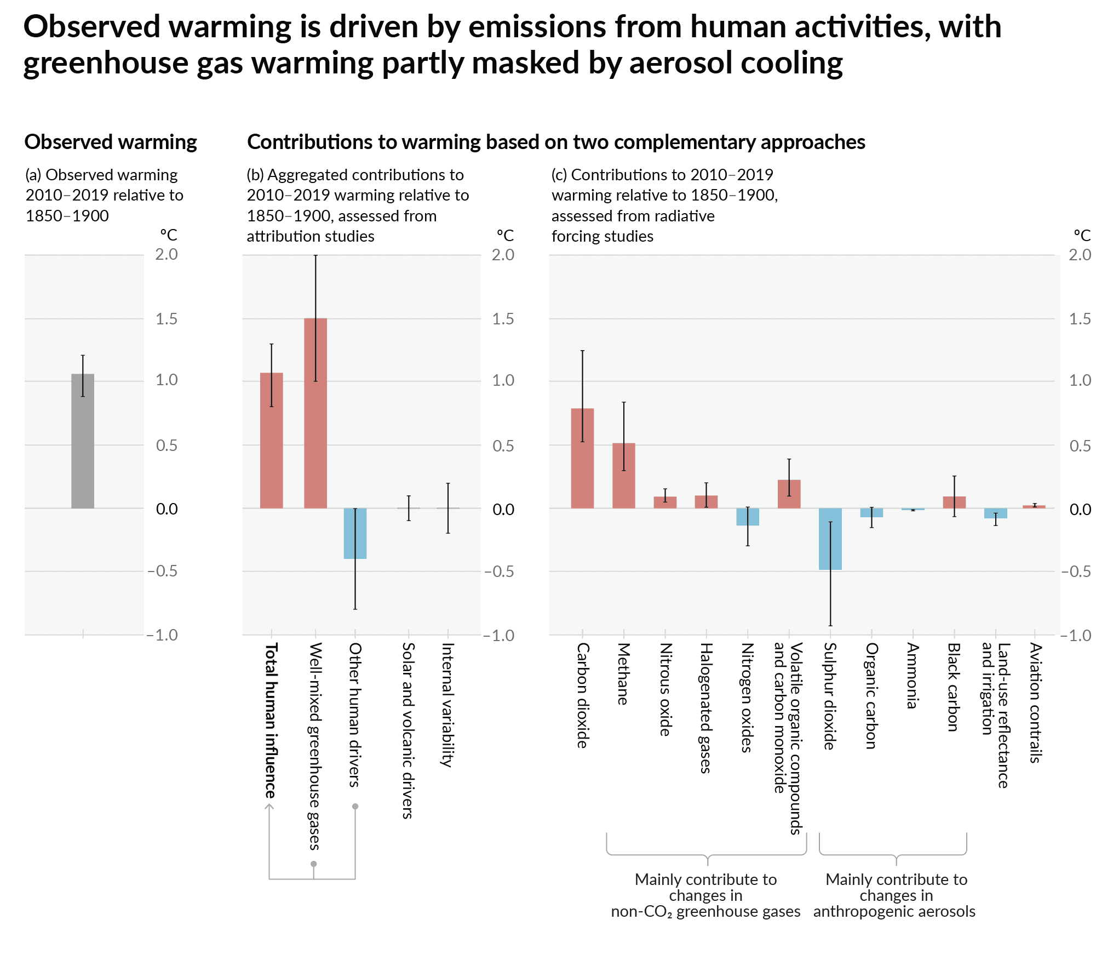

Slide 9
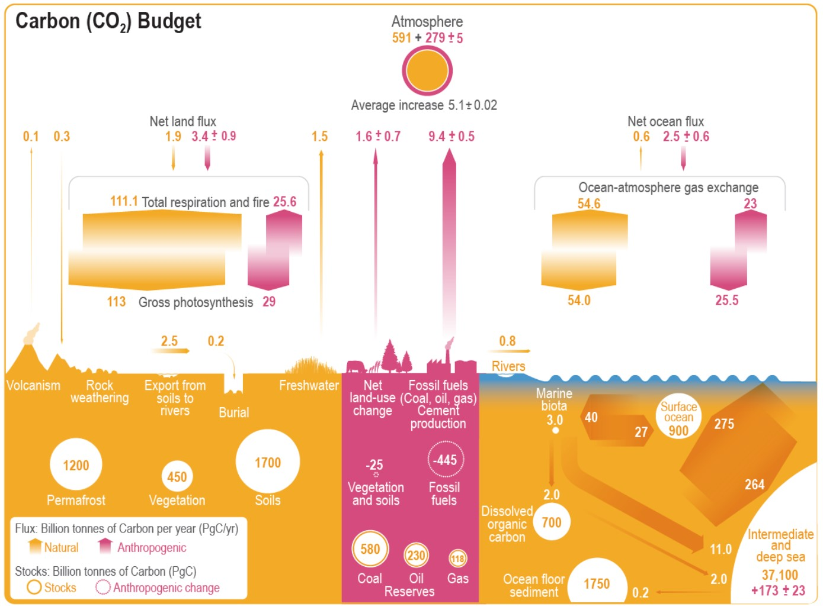

Slide 10
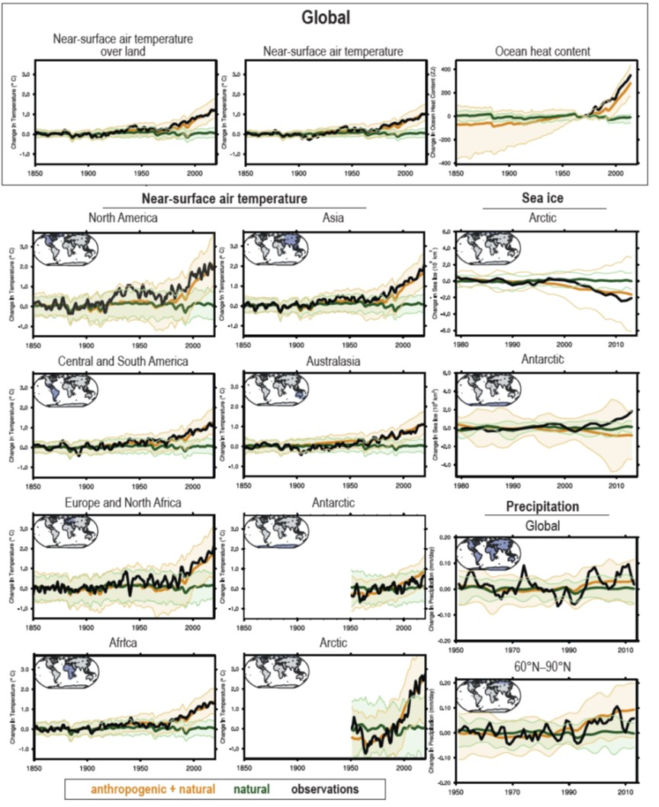

Slide 11
Climate Science
The (enhanced) greenhouse effect and observed climate change
General circulation models
Projected climate change

Slide 12
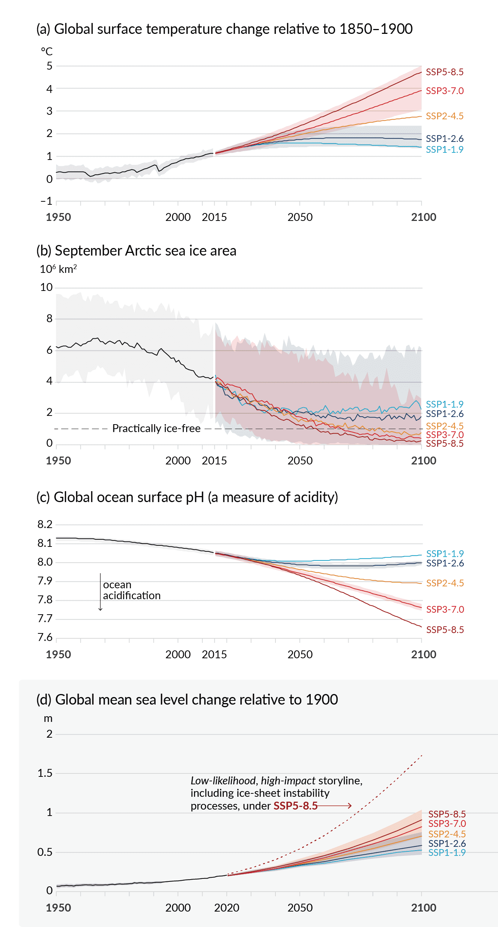

Slide 13
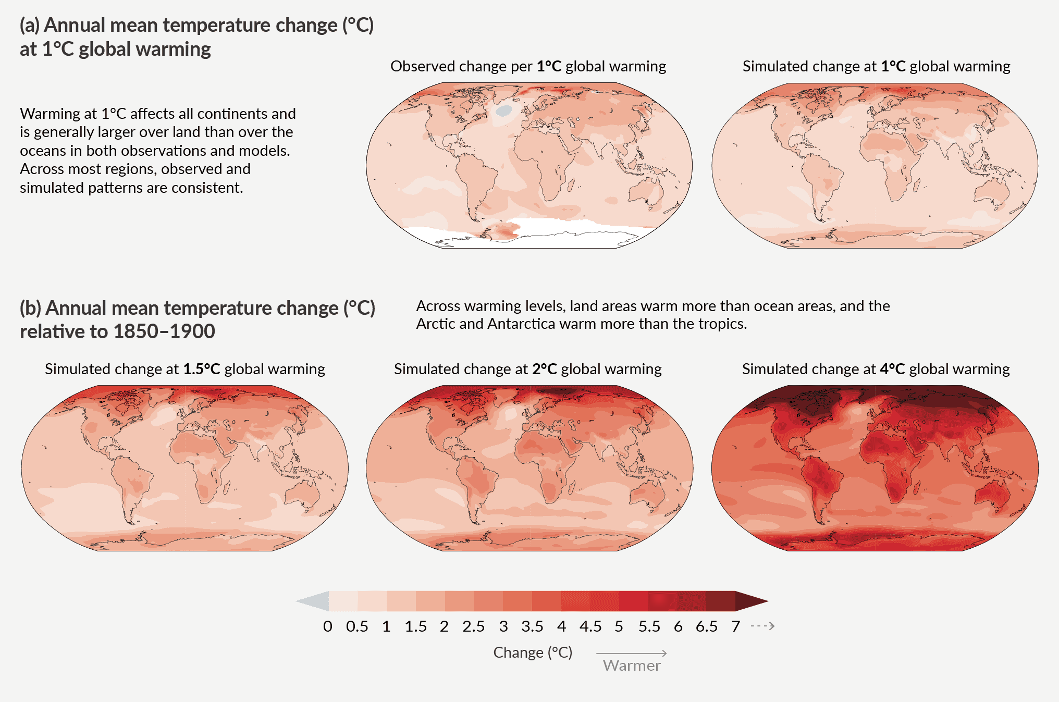

Slide 14
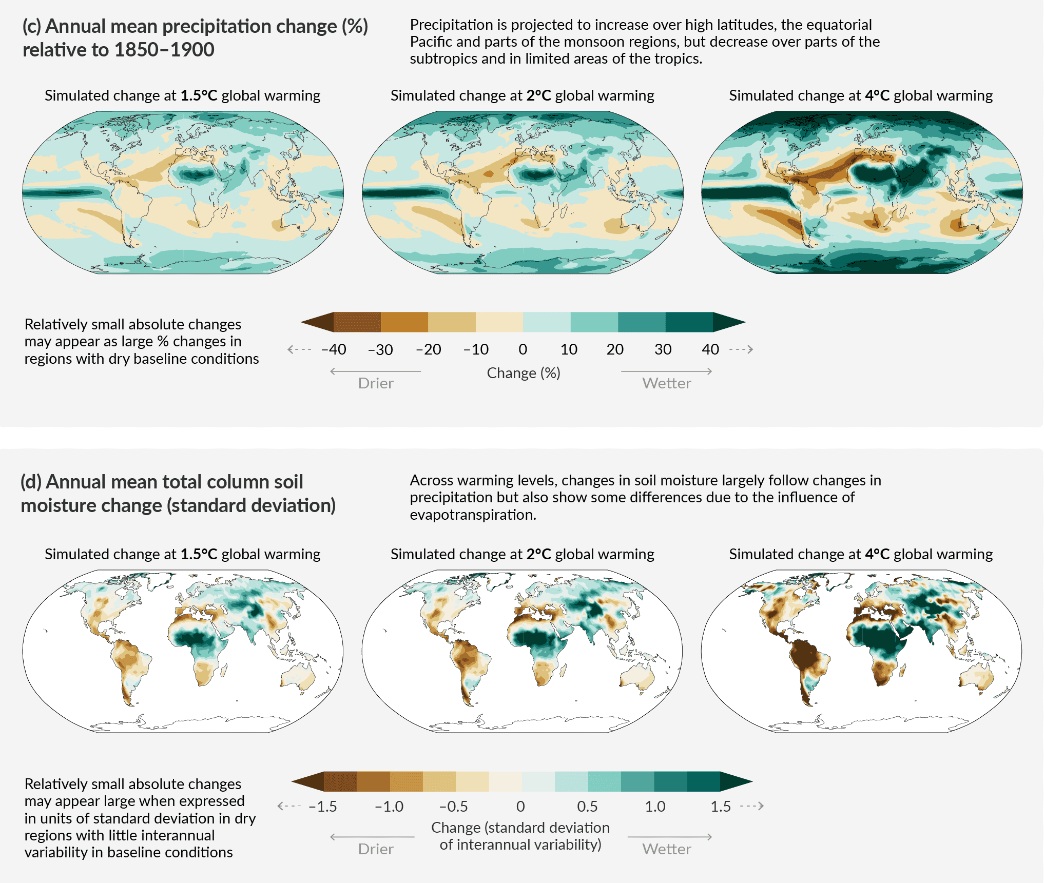

Slide 15
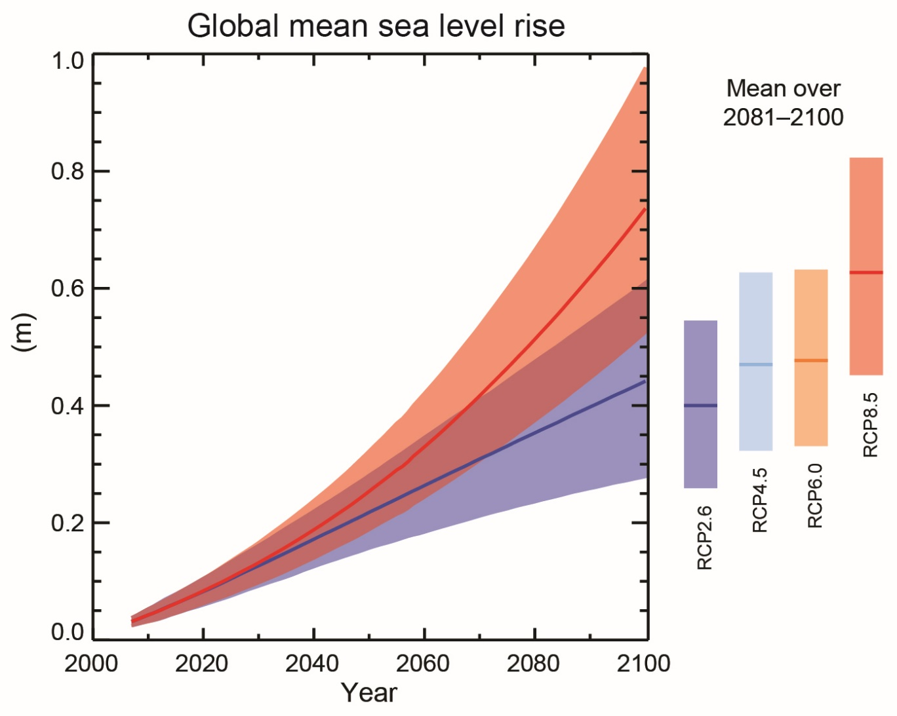
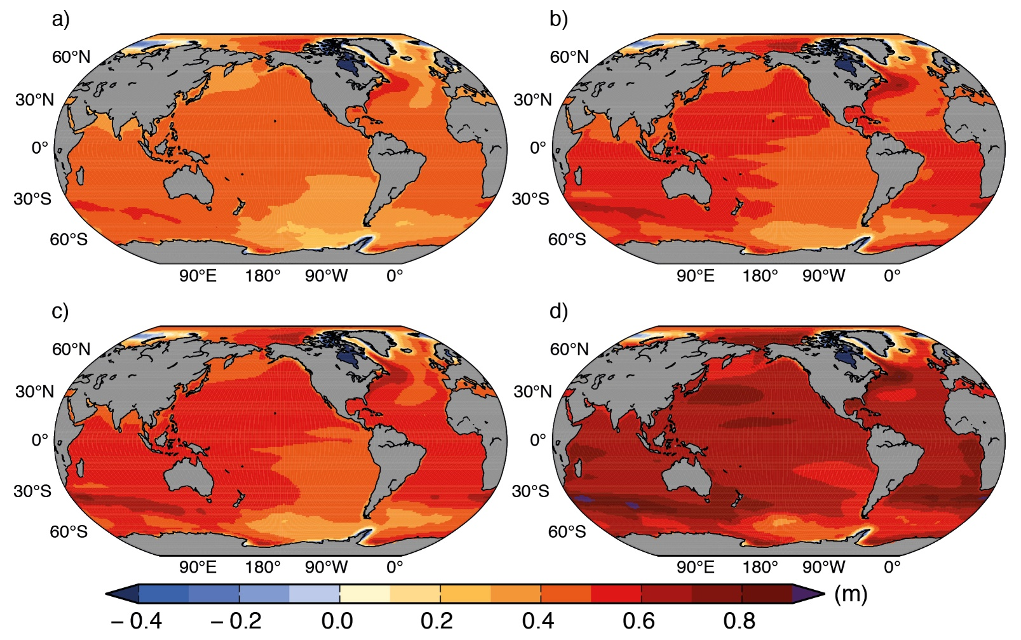
Water expands as it warms. A little bit. Ocean is on average 3 km deep. Tiny
expansion is large to humans.
Furthermore, ice melts or may slide
into sea.

Slide 16
Other effects
Rainfall
Some places will get wetter, others drier
Some places will get wetter in winter and drier in summer
Ocean acidification
The proper name for (dissolved) CO2 is carbonic acid
As there is more CO2 in the atmosphere, there is more CO2 in the ocean
This increases the acidity of sea water
Bad for calciferous species
Storms
Extratropical storms: Probably more intense
Tropical storm: Probably no change in area or frequency, but probably more violent

